Slide 1

TRIPLE CARRY AVOIDANCE
1

Slide 2




College Name
SRM Institute of Science and Technology​
Jadavpur University​
Indian Institute of Engineering Science and Technology
2

Slide 3







PROFESSOR IN CHARGE
NAME Dr K. Kalimuthu.
EMAIL ID kalimutk@srmist.edu.in .
DISCIPLINE Electronics and communication engineering.
YEAR Not applicable.
MOBILE 98416 31531
3

Slide 4
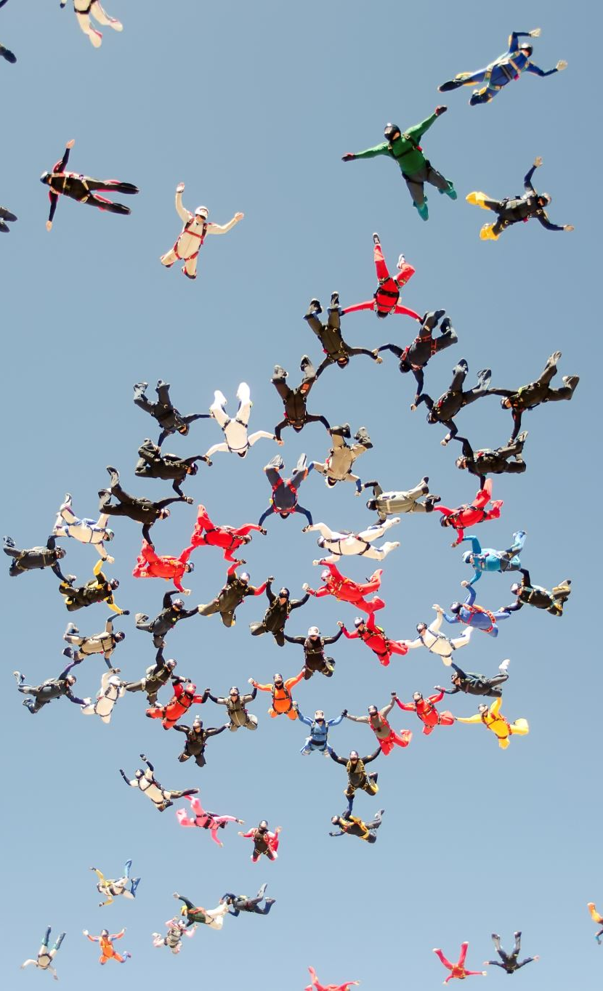
Team member details
4

Slide 5

TEAM MEMBER 1
NAME Aryan N
EMAIL ID panakalaryan@gmail.com
DISCIPLINE CSE Cloud Computing
YEAR 3rd year
MOBILE 9978115598
5

Slide 6
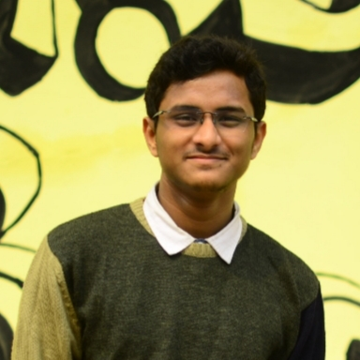
TEAM MEMBER 2
NAME Abhishek Sarkar
EMAIL ID abhisrkr007@gmail.com
DISCIPLINE Electronics and telecommunication engineering
YEAR 3rd year
MOBILE 6290782054
6

Slide 7

TEAM MEMBER 3
NAME Ahel Das Chatterjee
EMAIL ID aheldc@gmail.com
DISCIPLINE Department of Computer Science and Technology
YEAR 3rd year
MOBILE 8617791548
7

Slide 8
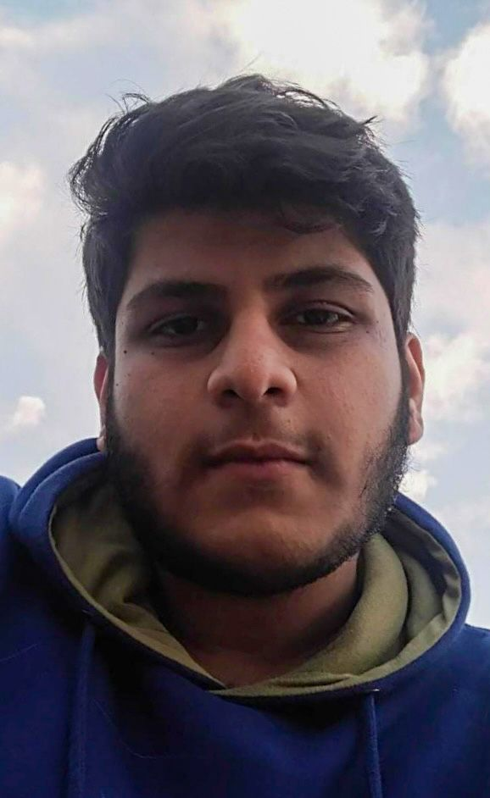
TEAM MEMBER 4
NAME Ved Prakash Dubey
EMAIL ID dvedprakash2001@gmail.com
DISCIPLINE CSE-SWE
YEAR 3rd year
MOBILE 9674990810
8

Slide 9
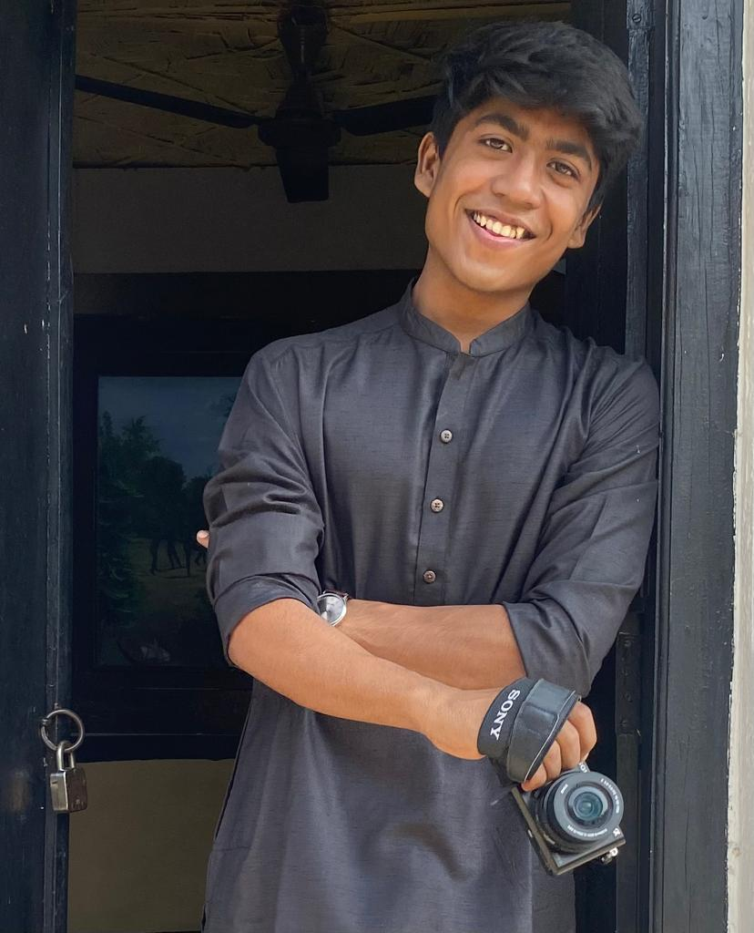
TEAM MEMBER 5
NAME Pushpal Das
EMAIL ID pushpaldas2001@gmail.com
DISCIPLINE Electronics and Communication Engineering
YEAR 3rd year
MOBILE 8910497557
9

Slide 10
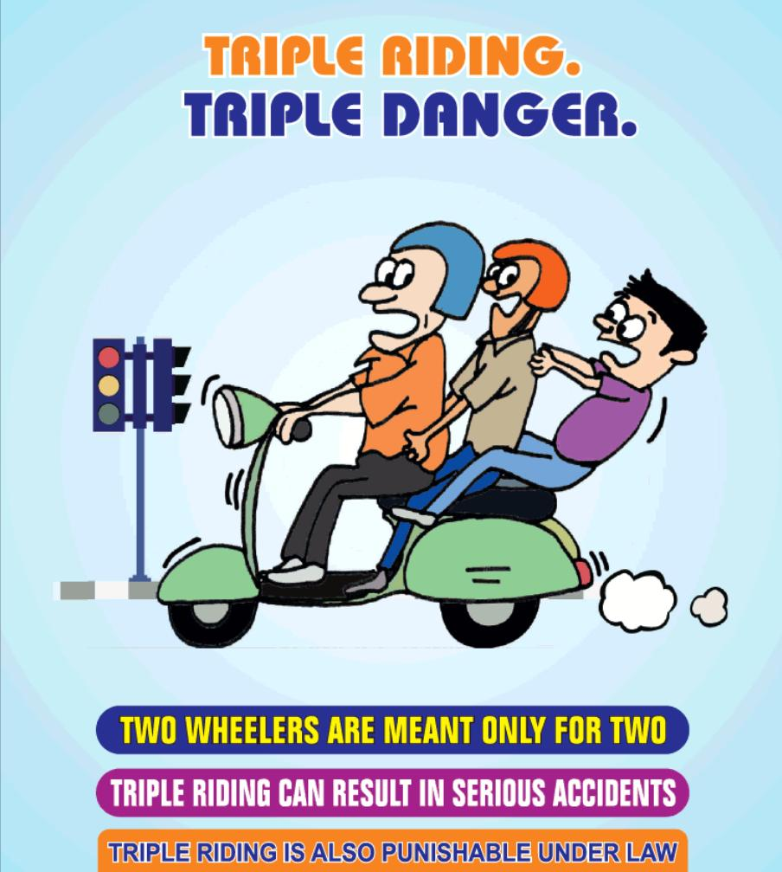
ABSTRACT
In many states the traffic signals have been upgraded into smarter solutions, but real-time surveillance and regulation of traffic rule offenders is yet to be seen.
Triple carry is prohibited by law in our country, and yet the offense is rarely talked about and looked upon by the traffic police.
It is not only illegal, but also risky and dangerous for multiple people. The motorcycle driver along with two riders pose risk to their own lives as well as that of other people. This is because when a motorcycle that is meant to carry two people gets the load of three, it loses its structural balance and the suspension poses risk of damage.
This phenomenon is widely seen in small localities where people need not travel long distances. Such a place where we tried to bring smarter surveillance and regulation was our university campus in Tamil Nadu, India.
10

Slide 11

PROBLEM STATEMENT/ CHALLENGES
Triple carry on two wheeler inside SRM Institute of Science and Technology, Kattankulathur
The university provides guards present at the entry gate to the campus for identity verification, for safety standards - like checking body temperature for covid, wearing a helmet when you are on a two wheeler, and checking whether there is any triplet on the bike before entering to the campus.
But it is generally outside the campus at the gates where one can get access for checking for triple carry and not inside the campus as it is not possible for guards to check at each and every turn inside the large area of the campus.
So in most of the cases, for students who carry a third person on their bikes outside the campus, when they reach near the checking point on the gate, they drop one and enter successfully without scrutiny carrying the other person in their bikes.
On the other hand the other rider enters the campus on foot and again gets up on the bike, resulting in a triple carry. Thus, the checking near the entrance gate is not efficient when it comes to curbing triple carry.
11

Slide 12
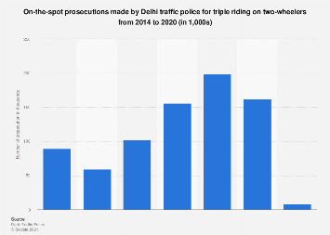
GRAPHICAL ANALYSIS
12

Slide 13
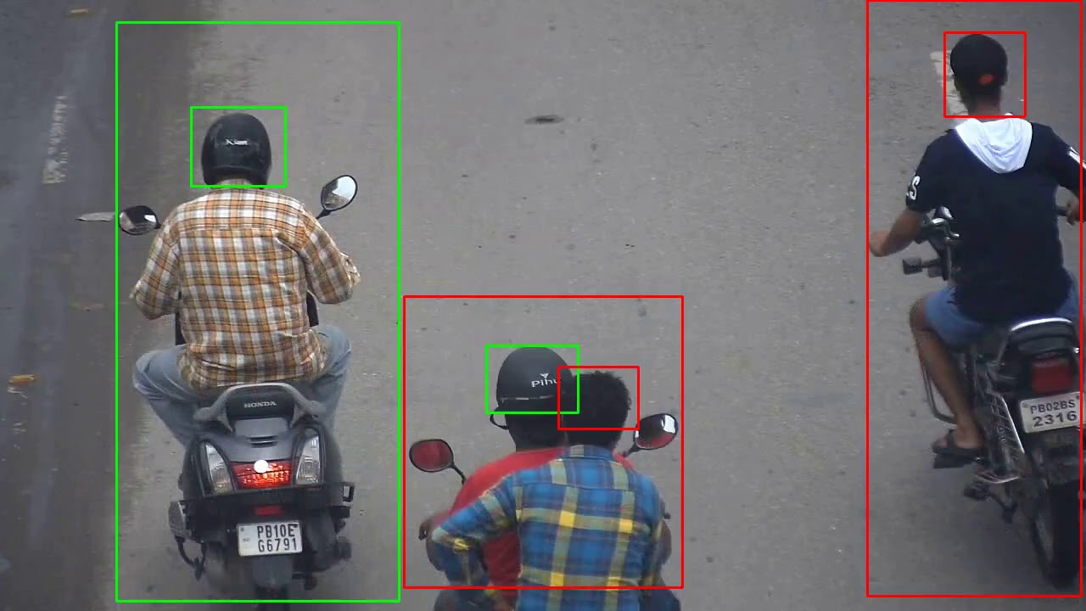
SOLUTION
A viable solution could be to checking the number plates and punishing the repeat offenders or warning triplets on their first entry to the database of offenders.
The notice can be sent to the respective students by message or e-mail. If the surveillance system is unable to capture the number plate of the vehicle, then other information like the colour and model of the motorcycle, colour of helmets and clothing, posture of the rider, etc can be used to predict if the bike has previous records of triple riding. If the rider is not wearing helmets then the same system can issue a notice to them.
13

Slide 14
SOLUTION
To achieve this we use Digital Image Processing algorithms and process real-time CCTV footage for checking if a two-wheeler has three riders or if a biker is not wearing a helmet.
A local database is maintained with the details of the motorcycles and the riders, segregated into first-time offenders and repeat-offenders. A notice is immediately sent to those caught in the act.
A separate solution is to introduce bicycles for rent inside the campus and ban motorcycles altogether.
13

Slide 15
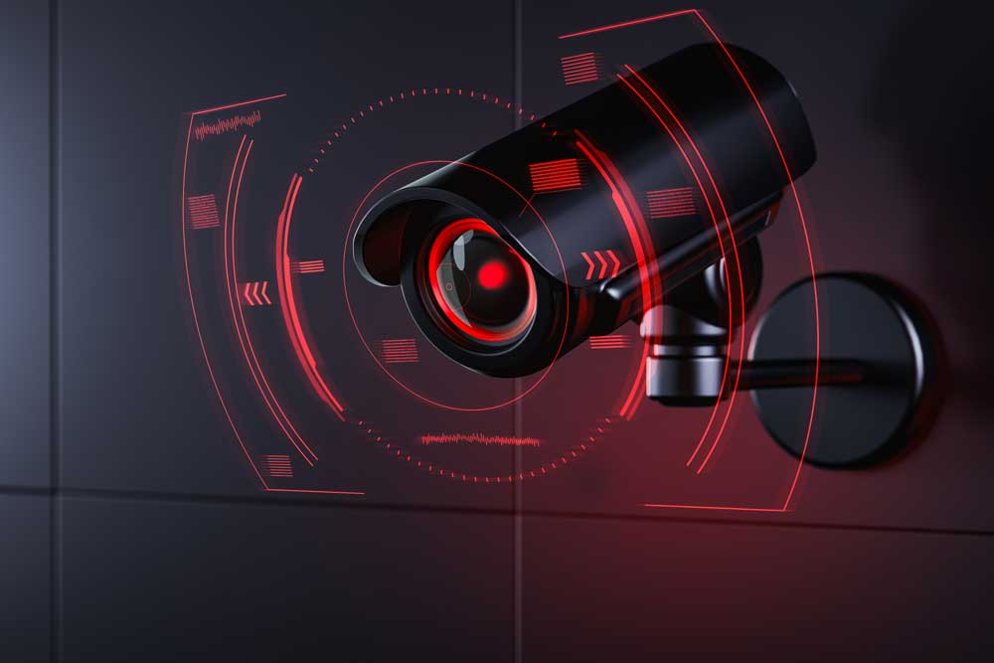
C O N C L U S I O N
As mentioned, triple carry on two-wheelers has been made a punishable and fineable offence across the country and is being enforced strictly.
This is due to various reasons ranging from personal to civic safety that is endangered by triple riding on a bike. This makes it all the more important to ensure that through technology we can help in better and more efficient enforcement of this law on our campus.
Our technology can bring down the number of repeat-offenders. This technology can also be applied throughout the country and potentially help in decreasing one of the major causes of bike or traffic accidents.
14

Slide 16
R
E
S
O
U
R
C
E
S
Website
India: triple riding prosecutions by Delhi traffic police 2020 | Statista
Mission Road Safety on Twitter: "Tripple riding is not only dangerous for whoever rides but also to the other people around them. Don• 't indulge in tripple riding or over loading on two wheelers. https://t.co/CvVa1qxx77" / Twitter
SRM Institute of Science and Technology releases engineering rank list | The News Minute
Stanley focuses on the future of remote monitoring | SecurityWorldMarket.com
15

